Slide 1
CAD
B-Spline curves

Slide 2
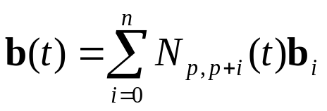




Definition
Given n+1 control points b₀, b₁, ..., b_{n}, a knot vector T = {t₀, t₁, ..., t_{m}}
the B-spline curve, b(t) of order p
t₀
t₁
t₂
…
t_{p}
t_{m−p}
t_{m−p+1}
t_{m}
…

Slide 3
B-spline curve
  very similar to a Bézier curve wherein the basis functions are the Bernstein polynomials
  In a Bézier curve, the degree of Bernstein basis functions is the same as the number of control points
  For B-spline curves, the degree of the basis functions is an independent choice specified by the user
  The number of knots (m+1) get determined by the relation, m = n + p
    - the total number of basis functions (n+1) = number of control points
    - P is the order of the B-spline basis functions and hence the curve

Slide 4
Parametric range of
B-spline curve
  B-spline curve definition is valid for all t in
  [−∞, ∞], b(t) = 0 for t ≤ t₀ and t > t_{m}
    range [t₀, t_{m}] seems reasonable
  More restrictive range: in which full support of the basis functions is achieved
    i.e., over any knot span [t_{j}, t_{j+1}) in [t₀, t_{m}], all p B-splines of order p are non-zero
  first such span is [t_{p-1}, t_{p}) where N_{p,p}, …, N_{p,2p-1} are non-zero
  last span is [t_{m-p}, t_{m-p+1}) where basis functions N_{p,m-p+1}, …, N_{p,m} are non-zero
  range of definition of a B-spline curve [t_{p-1}, t_{m-p+1}) wherein for any t all p basis functions are non-zero

Slide 5


Parametric range of
B-spline curve …
First span to include all
p basis functions
Last span to include all
p basis functions
t₀
t₁
t₂
…
t_{p-1}
t_{p}
t_{2p-1}
t_{m−p}
t_{m−p+1}
t_{m}
…

Slide 6
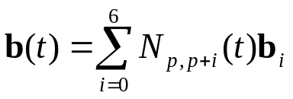
Example
For data points, (0, 0), (0, 1), (2, 3), (2.5, 6), (5, 2), (6, 0) and (7, −3), design a B-spline curve
using piecewise cubic polynomial segments
Number of data points
: 7
: 7 + 4 = 11
Number of knots
Order of basis function
: 4
Our choice to specify knots
[0, 1, 2, 3, 4, 5, 6, 7, 8, 9, 10)
6
[0, 3, 3, 3, 4, 5, 6, 7, 8, 9, 10)
3
Y(t)
[0, 3, 3, 3, 4, 5, 6, 7, 7, 7, 10)
3
7
0
8
X(t)

Slide 7


Properties of B-spline Curves
A B-spline curve is a piecewise curve with each component an order p segment
Equality m = n + p must be satisfied
  Strong Convex Hull Property:
  The B-spline curve, b(t) is contained in the convex hull defined by the polyline,
  [b_{j}, b_{j+1}, ..., b_{j+p-1}] for t in [t_{j+p-1}, t_{j+p}).
  This convex hull is the subset of the parent hull [b₀, b₁, ..., b_{n}]
b_{j}
b_{j+p-1}
p basis splines are barycentric
Hence, the property
t₀
t₁
…
t_{j}
t_{m}
t_{j+p-1}
t_{j+p}
t_{j+2p-1}
t_{m−p}
t_{m−p+1}

Slide 8
Strong Convex-hull property
6
3 ≤ t < 4
4 ≤ t < 5
5 ≤ t < 6
6 ≤ t < 7
Actual
Convex hull
-4
0
8

Slide 9
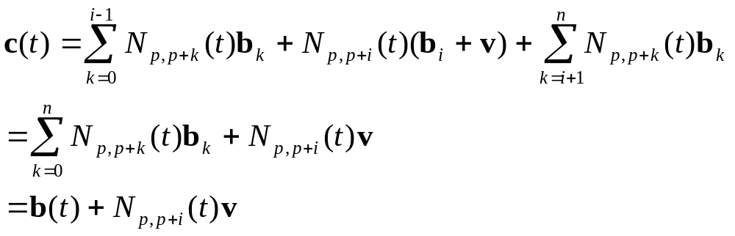
Properties of B-spline Curves…
b(t) is C^{p-k-1} continuous at a knot of multiplicity k
At t = t_{i}, a knot of multiplicity k, since N_{p,i}(t) is C^{p-k-1} continuous, so is b(t) at that knot
Local Modification Scheme: Relocating b_{i} only affects the curve
b(t) in the interval [t_{i}, t_{i+p})
Let the control point b_{i} be moved to a new position b_{i} + v
N_{p,i+p}(t) is non-zero in [t_{i}, t_{i+p})
for t ∈ [t_{i}, t_{i+p}), b(t) gets locally modified

Slide 10
Example local shape modification
6
-4
8
0

Slide 11
Design features with
B-spline curves
Shape manipulation can be done using
Control points
Use strong convex hull property
knots
Use knot multiplicity
Changing knot positions can also cause shape change but
Is non-intuitive and thus avoided

Slide 12
Shape change using
Control points
Recall
  Strong Convex Hull Property:
  The B-spline curve, b(t) is contained in the convex hull defined by the polyline,
  [b_{j}, b_{j+1}, ..., b_{j+p-1}] for t in [t_{j+p-1}, t_{j+p}).
  This convex hull is the subset of the parent hull [b₀, b₁, ..., b_{n}]
WHAT if b_{i}, b_{i+1}, ..., b_{i+p-1}, all are in a straight line ?
the curve segment lying their convex hull for t in [t_{i+p-1}, t_{i+p}) will be a straight line
What if p−1 of these control points are identical, say, b_{i} = b_{i+1} = ... b_{i+p-2} ?
the convex hull degenerates to a line segment b_{i}b_{i+p-1} and the curve passes through b_{i}
What if b_{i-1}, b_{i} = b_{i+1} = ... b_{i+p-2} and b_{i+p-1} are collinear ?
the line segment b_{i-1}b_{i+p-1} is tangent to the curve at b_{i}

Slide 13
p collinear data points
6
4
2
0
-2
-4
0
2
4
6
8

Slide 14
p-1 coincident data points
6
4
2
0
-2
-4
0
2
4
6
8

Slide 15
p-1 coincident data points with points in left and right collinear
6
4
2
0
-2
-4
0
2
4
6
8

Slide 16
Clamping using data points
6
4
2
0
-2
-4
0
2
4
6
8

Slide 17
Closed B-spline using Ctrl Points
6
4
2
0
-2
-4
-6
0
2
4
6
8

Slide 18
Shape manipulation using knot modification
Changing knot positions can also cause shape change but is non-intuitive and thus NOT RECOMMENDED
Change in curve’s shape using knot multiplicity is predictible
Recall
  At a knot i of multiplicity k, the basis function N_{p i}(t) is C^{p −1− k} continuous at that knot
  At each internal knot of multiplicity k, the number of non-zero order p
  basis functions is at most p− k

Slide 19
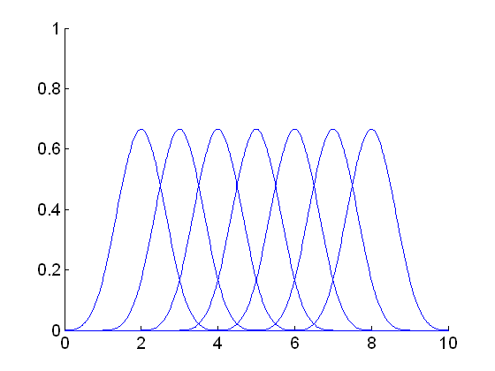
Multiple knots and
Barycentric property
At t = t₅, N_{4,9} = 0
N_{4,6}(t₅) + N_{4,7}(t₅) + N_{4,8}(t₅) = 1
N_{4,4}
N_{4,5}
N_{4,6}
N_{4,7}
N_{4,8}
N_{4,9}
N_{4,10}
t₀
t₁
t₂
t₃
t₄
t₅
t₆
t₇
t₈
t₉
t₁₀

Slide 20
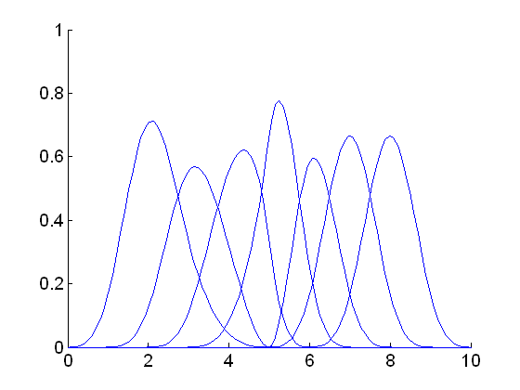
Multiple knots and
Barycentric property …
For t₄ = t₅, N_{4,8} = 0
N_{4,6}(t₅) + N_{4,7}(t₅) = 1
N_{4,7}
N_{4,6}
N_{4,8}
N_{4,9}
t₀
t₁
t₂
t₃
t₄
t₅
t₆
t₇
t₈
t₉
t₁₀

Slide 21
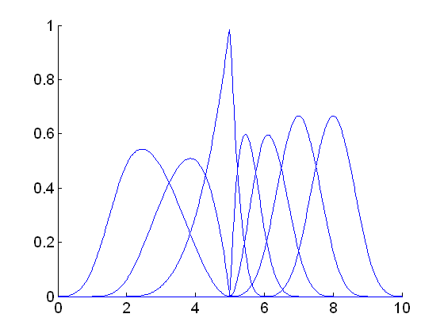
Multiple knots and
Barycentric property …
For t₃ = t₄ = t₅, N_{4,7} = 0
N_{4,6}(t₅) = 1
Control point associated with N_{4,6}(t)
Is b₂: the spline passes through b₂
N_{4,6}
N_{4,9}
N_{4,7}
N_{4,8}
t₀
t₁
t₂
t₃
t₄
t₅
t₆
t₇
t₈
t₉
t₁₀

Slide 22
Multiple knots and
Barycentric property …
if t_{i+1} = t_{i+2} = ,…, = t_{i+p-1} with t_{i+p-1} having multiplicity p–1
only one basis function N_{p,i+p} will be non-zero over t_{i+p-1}
from the barycentric property, N_{p,i+p} will be 1
the B-spline curve will pass through b_{i}

Slide 23
Example
t_{i} = i, i = 0, …, 15
6
range of full support [3, 12)
4
2
For spline to pass through (0, 0),
the knot t₄₊₄₋₁ = t₇ = 7 should have multiplicity 3.
t₅ = t₆ = t₇ = 7
0
For spline to pass through (8, 0),
the knot t₇₊₄₋₁ = t₁₀ = 10 should have multiplicity 3.
t₈ = t₉ = t₁₀ = 10
-2
-4
-6
0
2
4
6
8

